Slide 1

SPHENIX Detector/Tower Slope Method
Parker David Lewis
Advisor: Justin Frantz

Slide 2
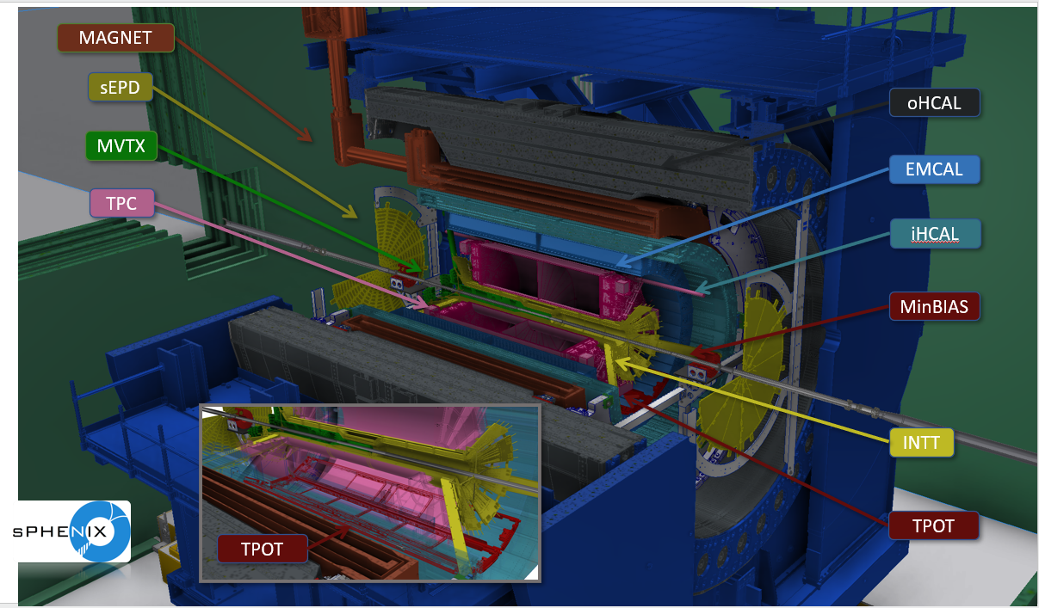
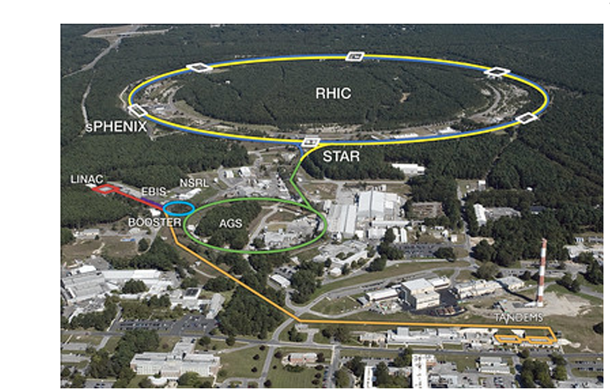
RHIC/SPHENIX Detector Overview

Slide 3
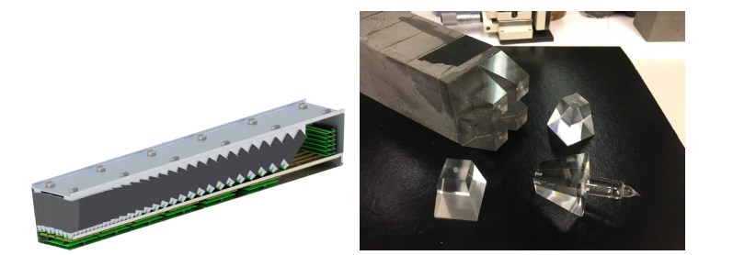
SPHENIX EM and Hadronic Calorimeters
EMCAL measures photons and electrons.
HCAL measures neutral hadrons.
Were mostly concerned with momenta and energy measurements
Basic Building blocks of both calorimeters are sectors and blocks. (384 towers) 94 towers)
The towers are defined as tiles of aluminum, scintillation material, and steal absorber plates.
SiPm’s are used a light to voltage pulse ADC conversion of electronics.

Slide 4
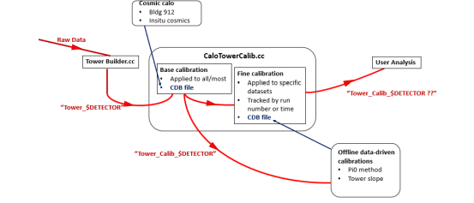
SPHENIX Calibration Procedures
The problem of calibration arises from the need to account for temperature and radiation dependencies of the equipment. Energy distributions of towers can vary over time and have strict position dependence.
Calibration Procedures of SPHENIX begin with multiple sequential steps of absolute calibration to get correct energy measurements and distributions.
Governing Equation: E_abs = N_ADC * Cal_abs.
N_ADC -> Number of ADC pulses counted
E_abs -> Absolute Energy
Cal_abs -> Calibration factor

Slide 5
Towerslope Method
The Towerslope method is one step within the calibration procedures. The main goals of tower slope are to get relative calibration factors called p1’s (define later).
The other goal is uniformize the towers either within two reference points in time or phi dependencies.
What tower slop does is to have two energy distributions of the same two within different reference points. The tower that needs to be adjusted is fitted by the good tower and has p1 calibration factor recovered.
Governing Relation: E_uniform = C_rel * N_ADC_tower.

Slide 6
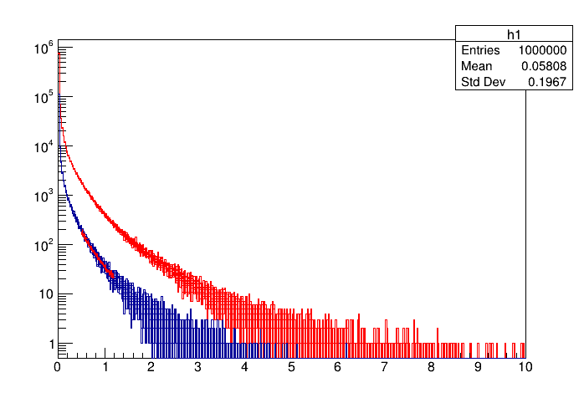
Towerslope Demonstration
A simple MC simulation is used to demonstrate the effectiveness of towerslope. To test it a reference histogram is loaded and then based on assumed QCD physics of collisions then, sampling is defined for the distributions.
A reference histogram (red histogram) of the energy distribution is loaded up with sampling and it is defined as user defines function for fitting of the tower distribution for later.
The key part of the demonstration is that a shift value is multiplied to the sampling of the tower distribution that needs to be adjusted to simulate the effect of tower distribution differences.
For the tower that needs to be adjusted (blue histogram) we then fit the reference TF1 within an energy range and get fit parameters back. One of these fit parameters p1 is called the calibration factor.
Counts
Energy (Gev)

Slide 7
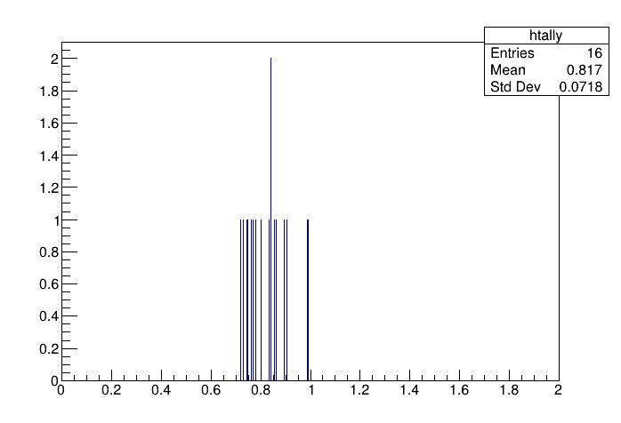
** The plot shows the results of 16 trials for which Input_decal = 0.75.
Average is consistent with the input.
The method here is used to calibration of EMCAL and HCAL.
Recovered Decal

Slide 8
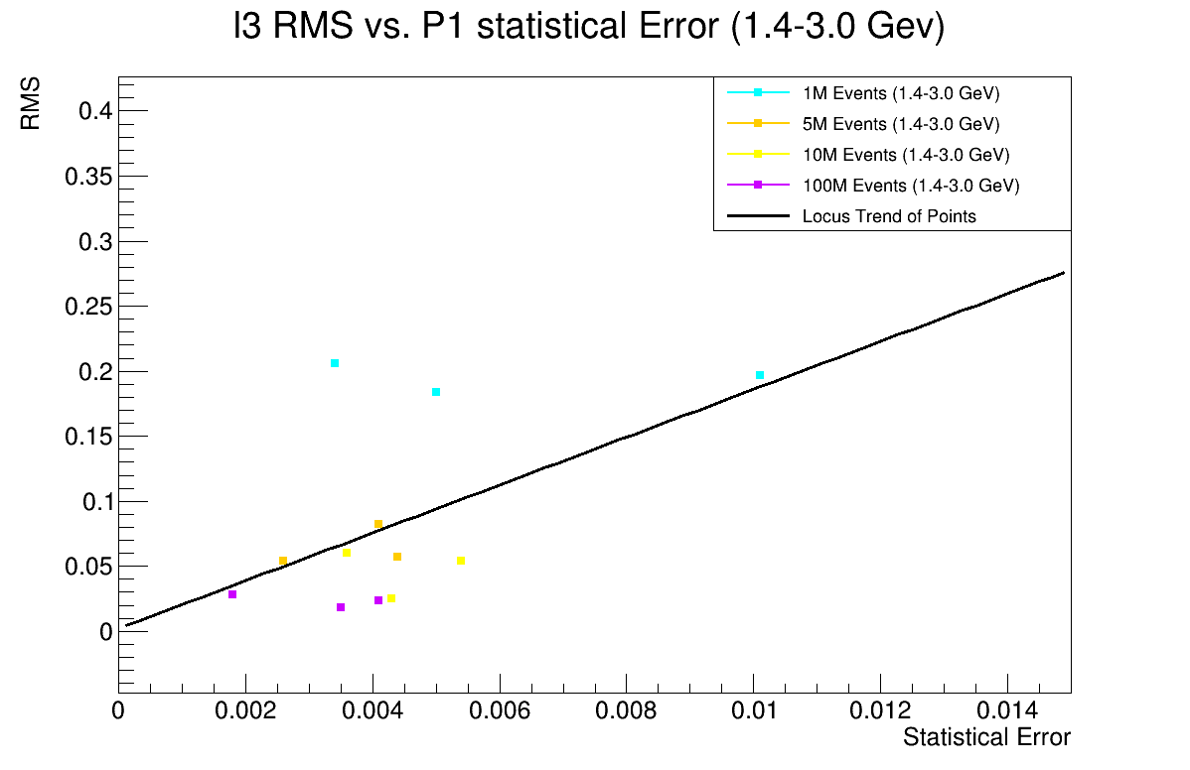
RMS Vs. Statistical Error plots Expo-L3:

Slide 9
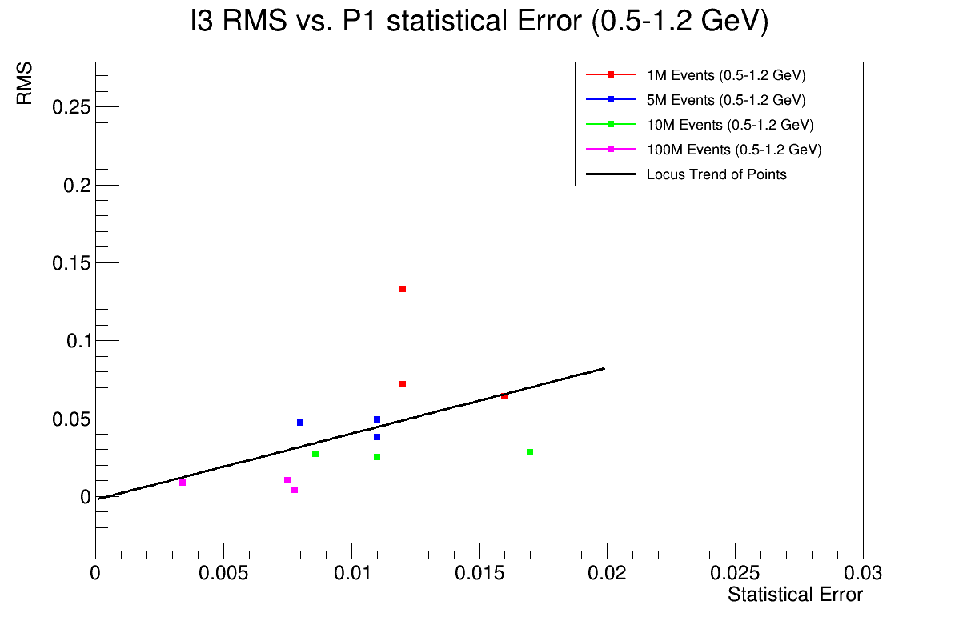

Slide 10
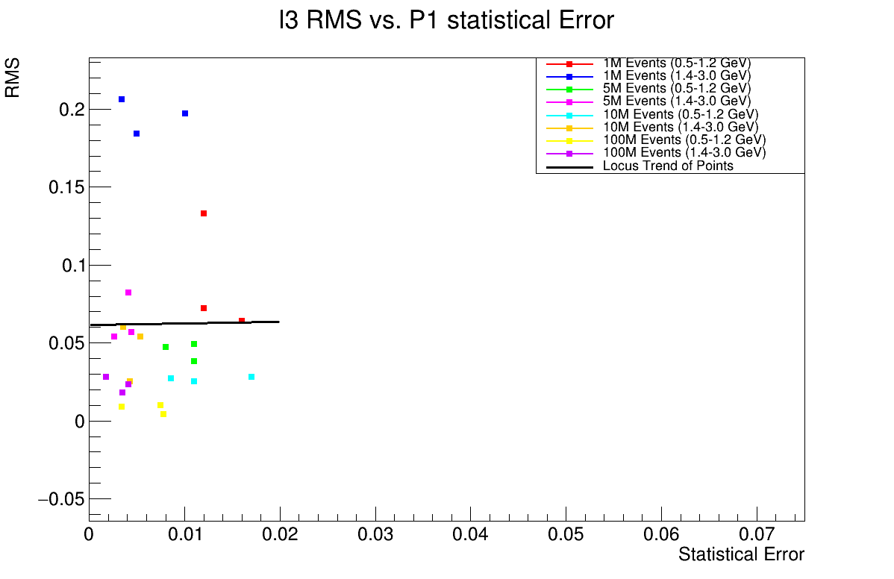

Slide 11
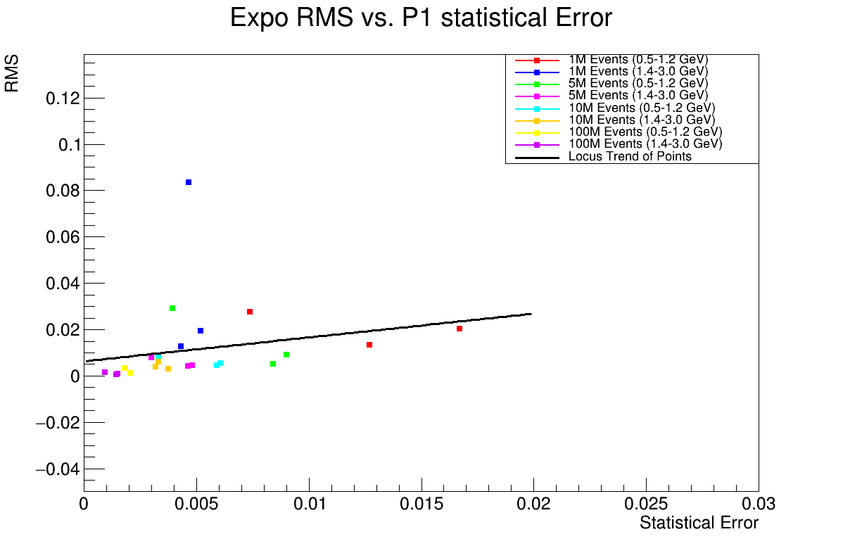

Slide 12
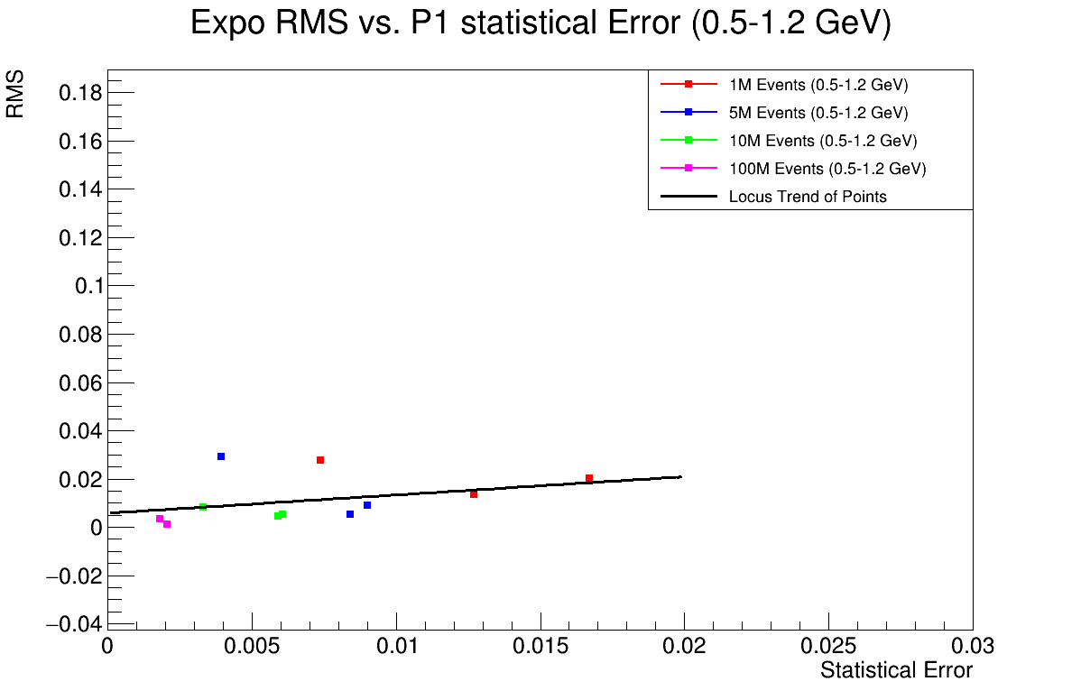

Slide 13
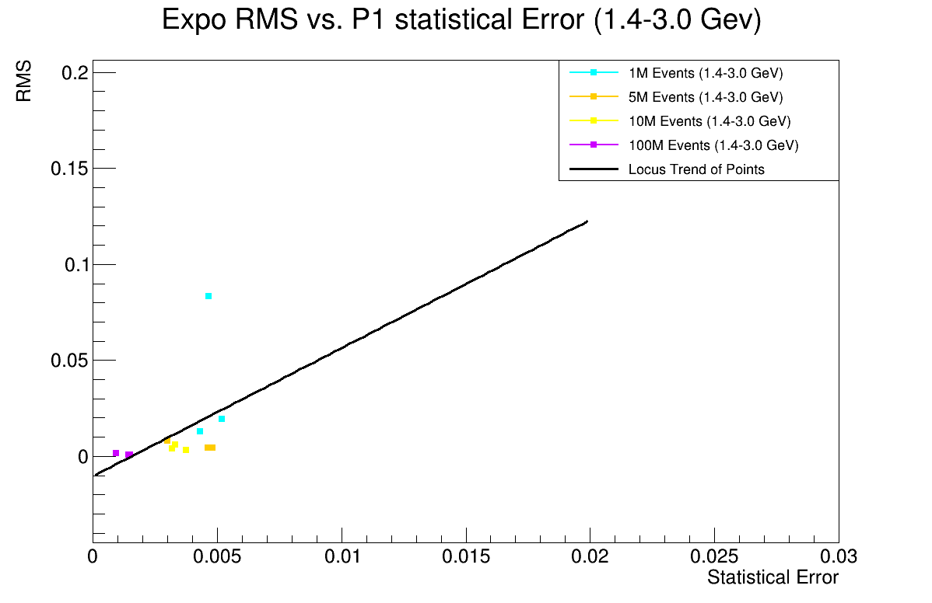

Slide 14
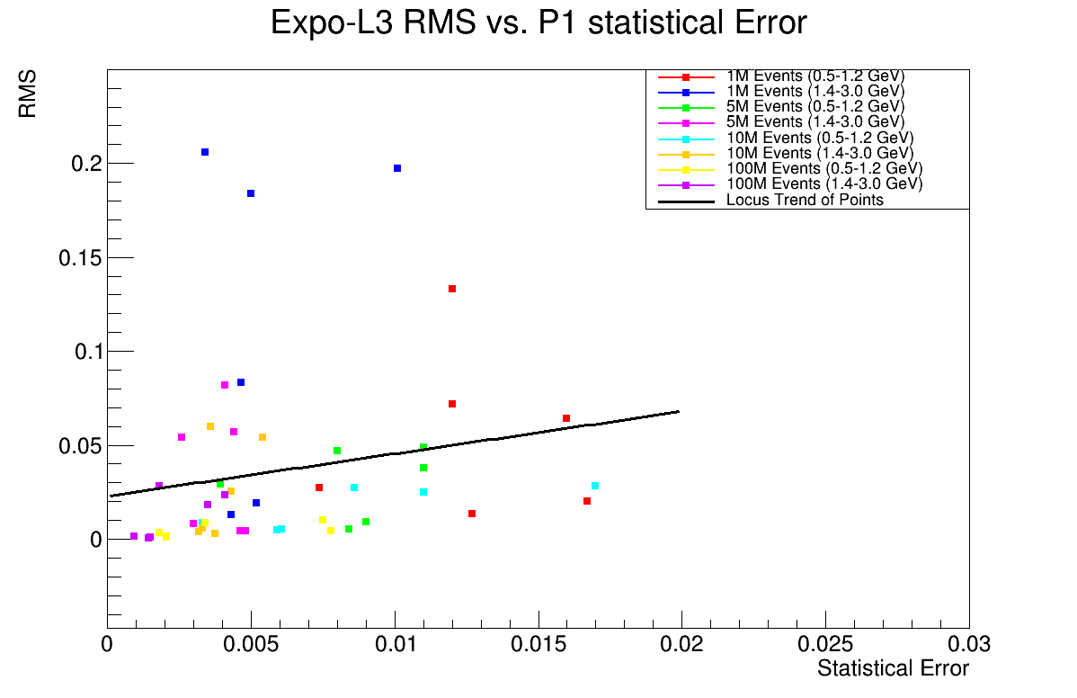

Slide 15
Correlation Tests L3-expo
The main correlation test applied was Pearson test, which is a linear correlation test of two measured quantities. The point here was to see if the statistical error affected the RMS of the measurements.
A. |r| < 1.0: (Strongest as closer to 1.)
B. |r| = 0 (No correlation of measurements)
This is where I’ll link to the txt file results of Corr tests:
Master_w/Masters_work at main · plewis3323/Master_w

Slide 16
Conclusions and Outlook
The Towerslope is successfully used to detect calib shifts …. On sphenix
RMS of the performance of the method is partially correlated of the statistical error of the fits as expected.
Outlook is to investigate why the correlation isn’t higher.

Slide 17
References
[1] S. B. Chauhan, “PHENIX π0 − h± Two Particle Correlations Measurements in 200 GeV Au+Au Collisions and Development of Pi0 Calibrations Technique for sPHENIX Electromagnetic Calorimeter,” Ph.D. Dissertation, Ohio University, August 2024.
[2] J. Bryan, “Development of the Tower Slope Method for Relative Calibration of sPHENIX Calorimeter Systems,” M.S. Thesis, Ohio University, Date not provided.
[3] sPHENIX Collaboration, “The Tower Slope Method: A Relative Calibration Tool for sPHENIX Calorimeter Systems,” sPHENIX Report, Version 0.1, DOI unspecified, June 19, 2024.

Slide 18
Backup Slides

Slide 19
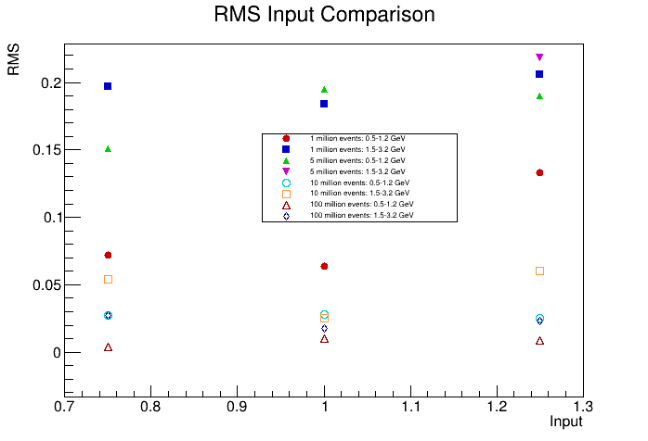
RMS Vs. Decalibration

